Slide 1



Indigenous Data Governance in the Australian Capital
Territory (ACT)
SciDataCom 2025, Meanjin
13th October
Bobby Maher (Yamatji, Noongar, Kija) & Ray Lovett (Wongaibon/ Ngiyampaa)
Maiam nayri Wingara Indigenous Data Sovereignty Collective

Slide 2
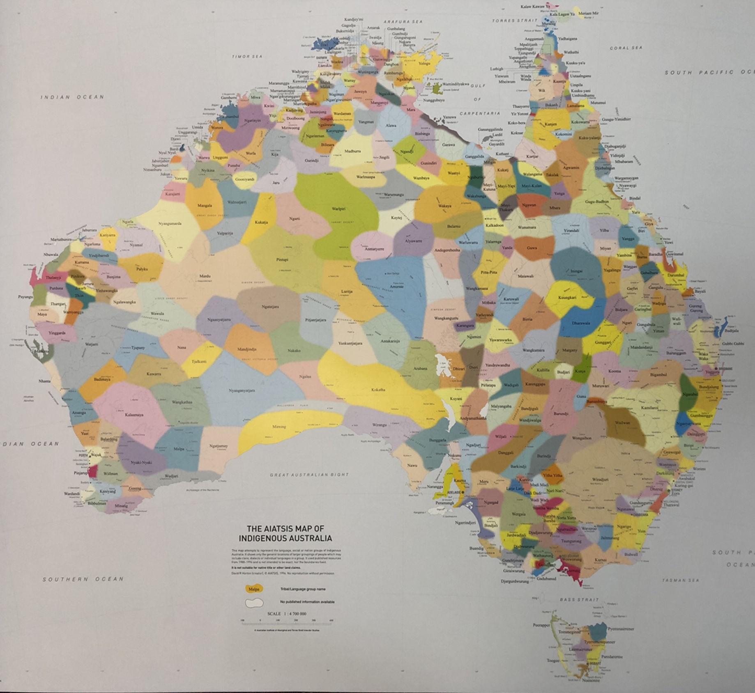

Acknowledgement and positionality
Bobby Maher
Ray Lovett

Slide 3
Overview
Indigenous Data Sovereignty – A Global Movement
Maiam nayri Wingara and IDSov Principles
Policy Context
Implementing Indigenous Data Governance in the ACT

Slide 4
What is Indigenous Data Sovereignty?
*Right of Indigenous Peoples to govern the collection, management access, interpretation, dissemination and reuse of data related to them
Acknowledges that Sovereignty already exists, and Indigenous Data Sovereignty is an extension of this
Relates to all data about Indigenous Peoples, Country and resources or has significant impact on these
Reaffirms Indigenous Peoples’ obligations to respect knowledge (data) and to recognise data as belonging to the collective
Premised on data accountability to Indigenous Peoples as per UNDRIP
Demands that data reflect Indigenous Peoples’ priorities and be used to enhance Indigenous collective wellbeing
Kukutai, T. & Taylor, J. (Eds.) (2016). Indigenous data sovereignty: Toward an agenda. ANU Press.
Snipp, M. (2016). What does data sovereignty imply? What does it look like? In T. Kukutai & J. Taylor (Eds.), Indigenous data sovereignty: Toward an agenda (pp. 39 – 55). ANU Press.
© Maiam nayri Wingara Indigenous Data Sovereignty Collective 2024
Notes:
Indigenous-developed and Indigenous-led philosophy
Asserts rights over data creation, ownership, access, and use
Grounded in self-determination
Global movement with local applications
Speaker Notes: Indigenous Data Sovereignty, or IDSov, is about the right of Indigenous peoples to govern the data that relates to them. It's a global movement but deeply rooted in local sovereignty, justice, and self-determination.

Slide 5
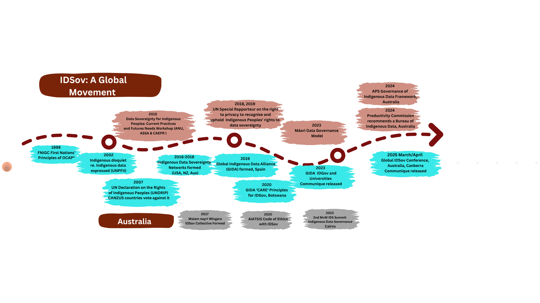
© Maiam nayri Wingara Indigenous Data Sovereignty Collective 2024

Slide 6



https://www.maiamnayriwingara.org/
© Maiam nayri Wingara Indigenous Data Sovereignty Collective 2024

Slide 7

Maiam nayri Wingara Inaugural Summit 2018
Delegates asserted that in Australia, Indigenous peoples have the right to:
Exercise control of the data ecosystem including creation, development, stewardship, analysis, dissemination and infrastructure.
Data that are contextual and disaggregated (available and accessible at individual, community and First Nations levels).
Data that are relevant and empowers sustainable self-determination and effective self-governance.
Data structures that are accountable to Indigenous peoples and First Nations.
Data that are protective and respects our individual and collective interests.
Reference: Maiam nayri Wingara. (2018). Indigenous Data Sovereignty Communique. Indigenous Data Sovereignty Summit 20th June 2018, Canberra, ACT.
t© Maiam nayri Wingara Indigenous Data Sovereignty Collective 2024

Slide 8
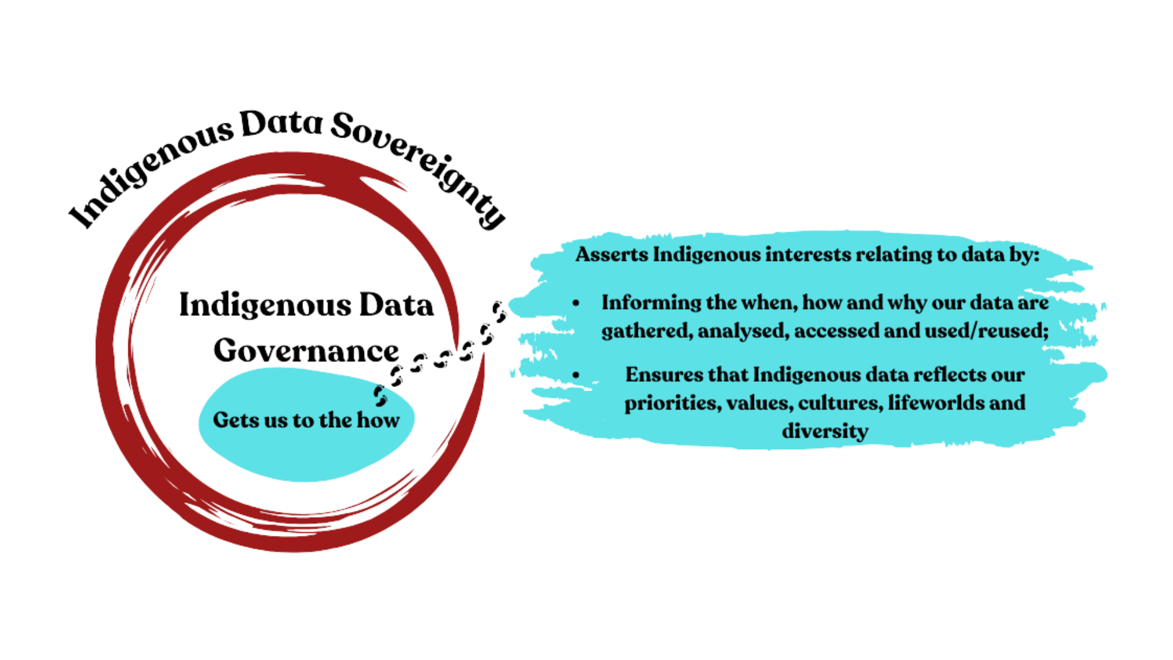
© Maiam nayri Wingara Indigenous Data Sovereignty Collective 2024

Slide 9
The Australian Policy Context
National Partnership Agreement on Closing the Gap
Governments commit to data sharing at a regional level
True change requires system-wide reform
Indigenous Data Governance (IDGov) needed to guide and implement IDSov

Slide 10

Australian Capital Territory
Indigenous population of 9,000 people in 2021 Census
Overall population of around 454,000 people

Slide 11
Implementing Indigenous Data Governance into the ACT Health Directorate
Maiam nayri Wingara
Indigenous Data Governance Structure
ACT Health Directorate
ACT Indigenous community
ACT Health Directorate Executive
Considers ACT Indigenous community
Exercising control of the data ecosystem, including how data are created, developed, stewarded, analysed, disseminated, and held within ACT Health data infrastructures.
Providing advice on context statements and disaggregation of data reporting from ACT Health data sets (available and accessible at individual, community, and First Nations levels).
How data from ACT Health empowers sustainable self-determination and effective self-governance.
How ACT Health data structures that are accountable to local Indigenous peoples.
How data compilation from ACT Health is protective and respects individual and collective interests.
© Maiam nayri Wingara Indigenous Data Sovereignty Collective 2024

Slide 12
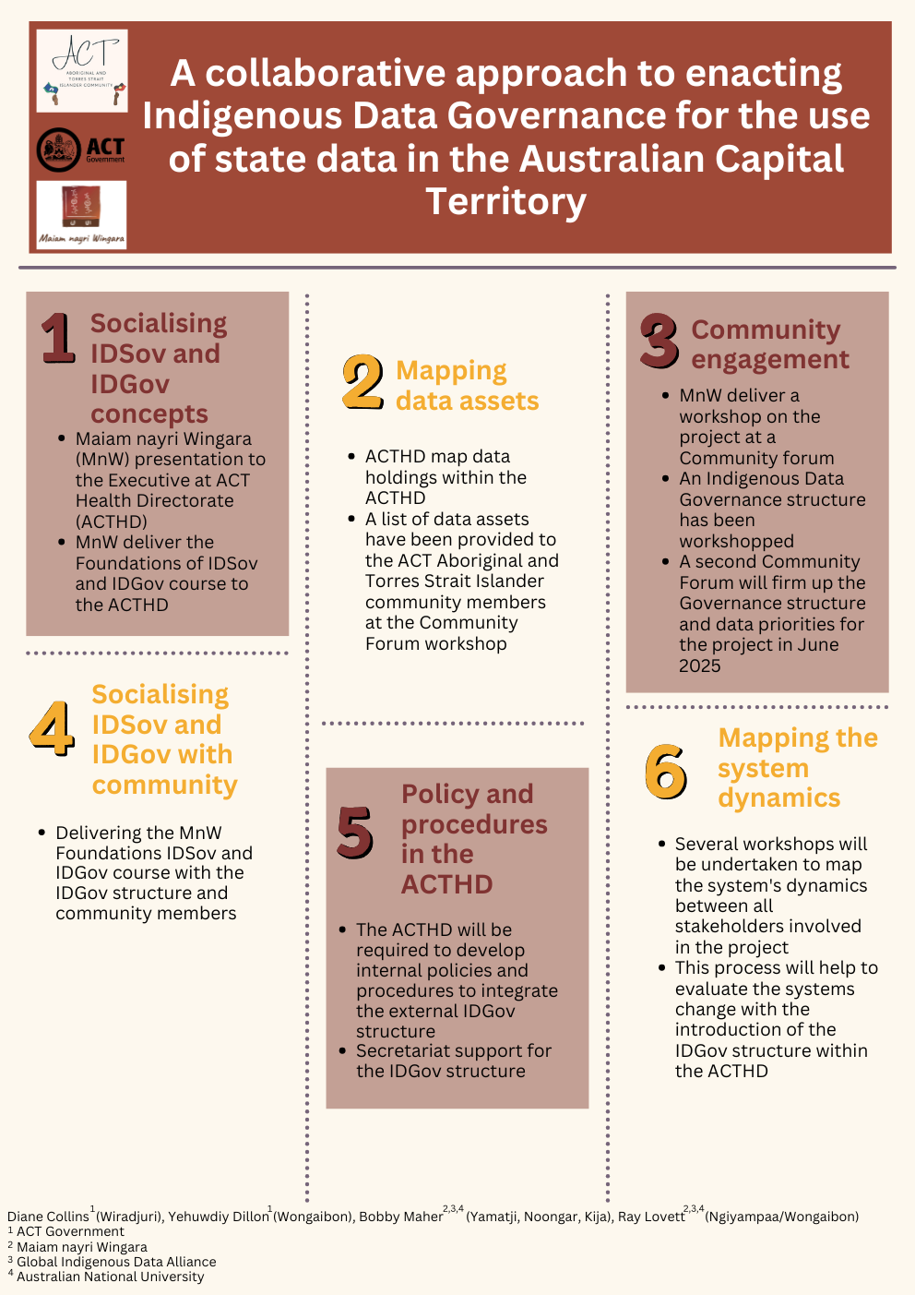
Notes:
Partners: Maiam nayri Wingara Collective, ACT Aboriginal and Torres Strait Islander community, ACT Health Directorate
Objective: Embed IDGov to realise IDSov
ACT as a demonstration site for national systems change
Speaker Notes: In this project, we brought together community, government, and Indigenous data experts to co-develop governance systems that return control to community.

Slide 13
Socialising the concepts
ACT Health Directorate Executive
Presented to the executive
Internal engagement with Data teams
Met with key data stewards and data custodians
Principles and project plan
Fundamentals of IDSov, Modules 1-3
Invited data stewards and data custodians to complete training
Outlines history and development of IDSov principles
Introduced the concepts of IDSov and IDGov
Project Plan
© Maiam nayri Wingara Indigenous Data Sovereignty Collective 2024

Slide 14
ACT Health Directorate Data
ACT Cancer registry
ACT Emergency Department Data Collection
ACT General Health Survey
ACT Maternal Perinatal Data Collection
ACT Non-Admitted Patient Data Collection
ACT Perinatal Death Data Collection
ACT Physical Activity and Nutrition Survey
ACT Prostate Cancer Outcomes Registry
Australasian Cardiac Outcomes Registry
Australian Secondary Students’ Alcohol and Drug Survey
Breast Cancer Treatment Group
Cause of Death Unit Record File
Notifiable Diseases dataset
Walk-in Centre
Year 7 Health Survey
ACT Kindergarten Health Check

Slide 15
Engagement with the ACT Aboriginal and Torres Strait Islander community
NAIDOC Family Day
MnW stall
Information and registration
Community Forum #1
Presented the project
Undertook a workshop on data
Community Forum #2
Complete IDGov structure
Data mapping around priorities
Developing IDGov structure
© Maiam nayri Wingara Indigenous Data Sovereignty Collective 2024

Slide 16
Socialising IDSov and IDGov concepts with partners
Fundamentals of IDSov, Modules 1-3
Invite those interested in the project
Set up IDGov structure
IDSov Fundamentals 4-8
Data Literacy and Practice training
TOR
© Maiam nayri Wingara Indigenous Data Sovereignty Collective 2024

Slide 17
Policy and Procedures in the ACTHD
The ACTHD will be required to develop internal policies and procedures to integrate the external IDGov structure
Secretariat support for the IDGov structure

Slide 18
Monitoring and evaluating the system
Several workshops will be undertaken to map the systems’ dynamics between all stakeholders involved in the project
This process will help to evaluate the systems change with the introduction of the IDGov structure within the ACTHD

